Slide 1
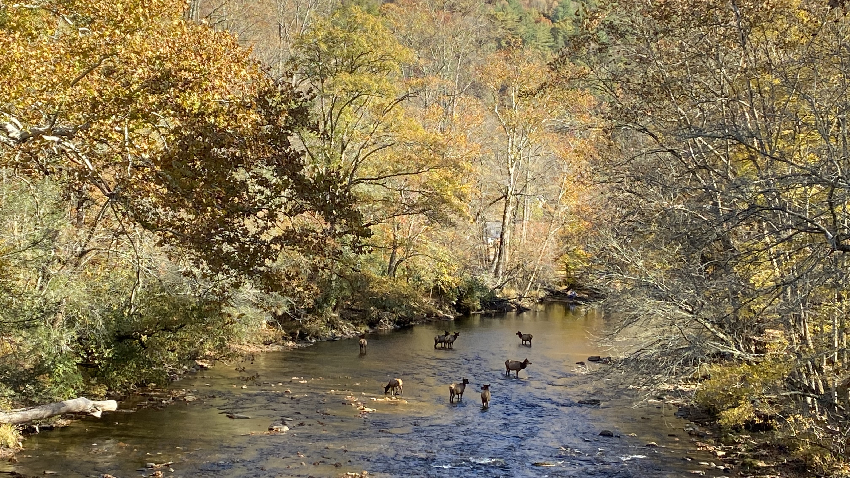
Applying to graduate school in Ecology & Evolutionary Biology
Brian O’Meara & Xingli Giam
Dept. of Ecology & Evolutionary Biology
U. of Tennessee, Knoxville

Slide 2
Caveats
Focus on US-based schools
Focus on programs with research-based Masters and PhD
Focus on ecology and evolution
Our experiences might not be predictive of yours: people are often treated differently due to age, gender, ethnicity, marital status, national origin, regional accents, wealth, and much more

Slide 3
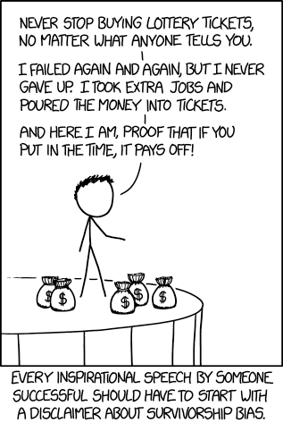
Careers in EEB with a Masters or PhD
Non-governmental Organizations (NGOs): Conservation, remediation, education
Government agencies: National / state parks, wildlife agencies, regulatory agencies
Academia: Lab manager, curator, tenure-stream faculty, non tenure-stream faculty
Industry: Research, data analysis, sustainability initiatives
Transferrable skills: Organize multiyear projects, write software, machine learning, data analytics, teaching
XKCD by Randall Munroe

Slide 4
Factor | Coursework Masters | Research Masters | PhD
Chapters (paper equivalents) | 0 | 1+ | 3+
Years | 2+ | 2-3 | 5-6
Prereq | BA/BS | BA/BS | BA/BS (most) Masters (some)
Cost | Student pays | Student or institution pays | Institution pays

Slide 5
In EEB programs, you typically get paid
This is very different from undergrad, med school, vet school, law school, etc.
The pay isn’t for school per se
Teaching assistant, who often will assist a professor in teaching, run labs, or run discussion sessions
Research assistant who helps a professor with their research
The pay is typically for 9 months of work; it can be paid out over 9 or 12 months. It usually only starts the month after you start working
It should be promised in your admission letter
Tuition should be included, also subsidized health care.
Fees may or may not be included (but this should be clear)

Slide 6
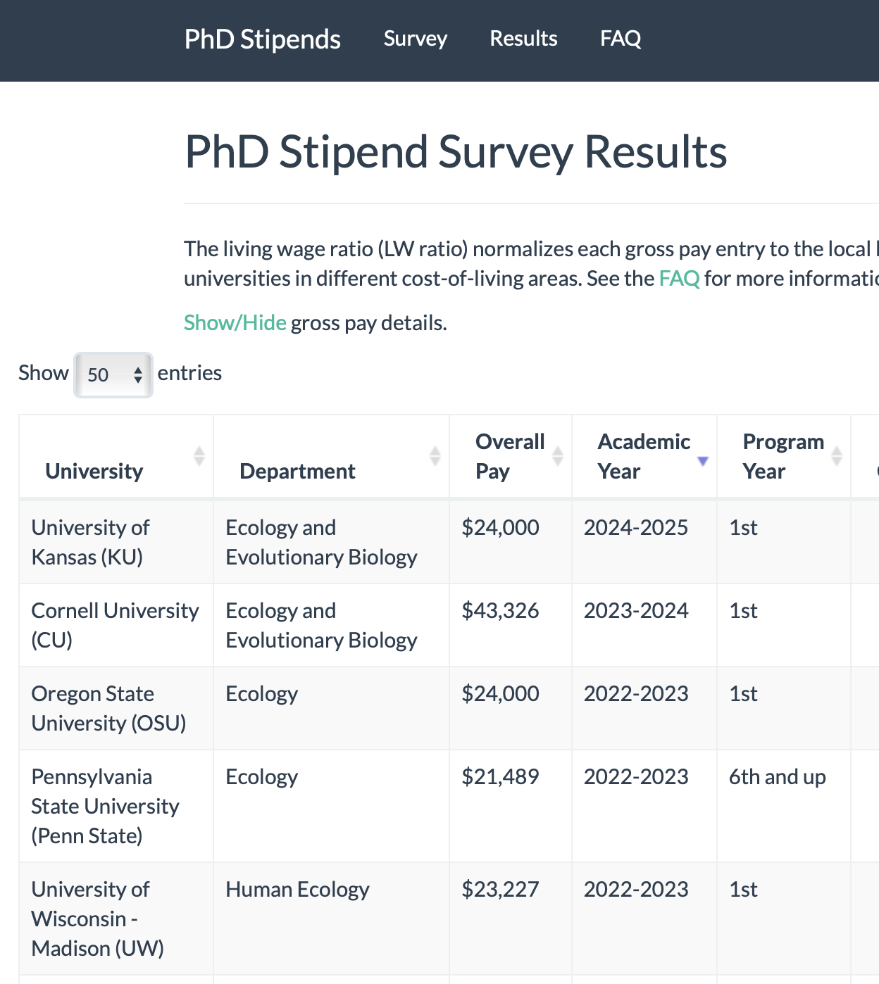
PhDStipends.com
Can be
Base pay for TA
Base pay + special fellowships for TA
RA pay from institution
RA pay from NSF
RA pay from NIH
Not necessarily predictive of what you
will be paid, but good for comparison

Slide 7
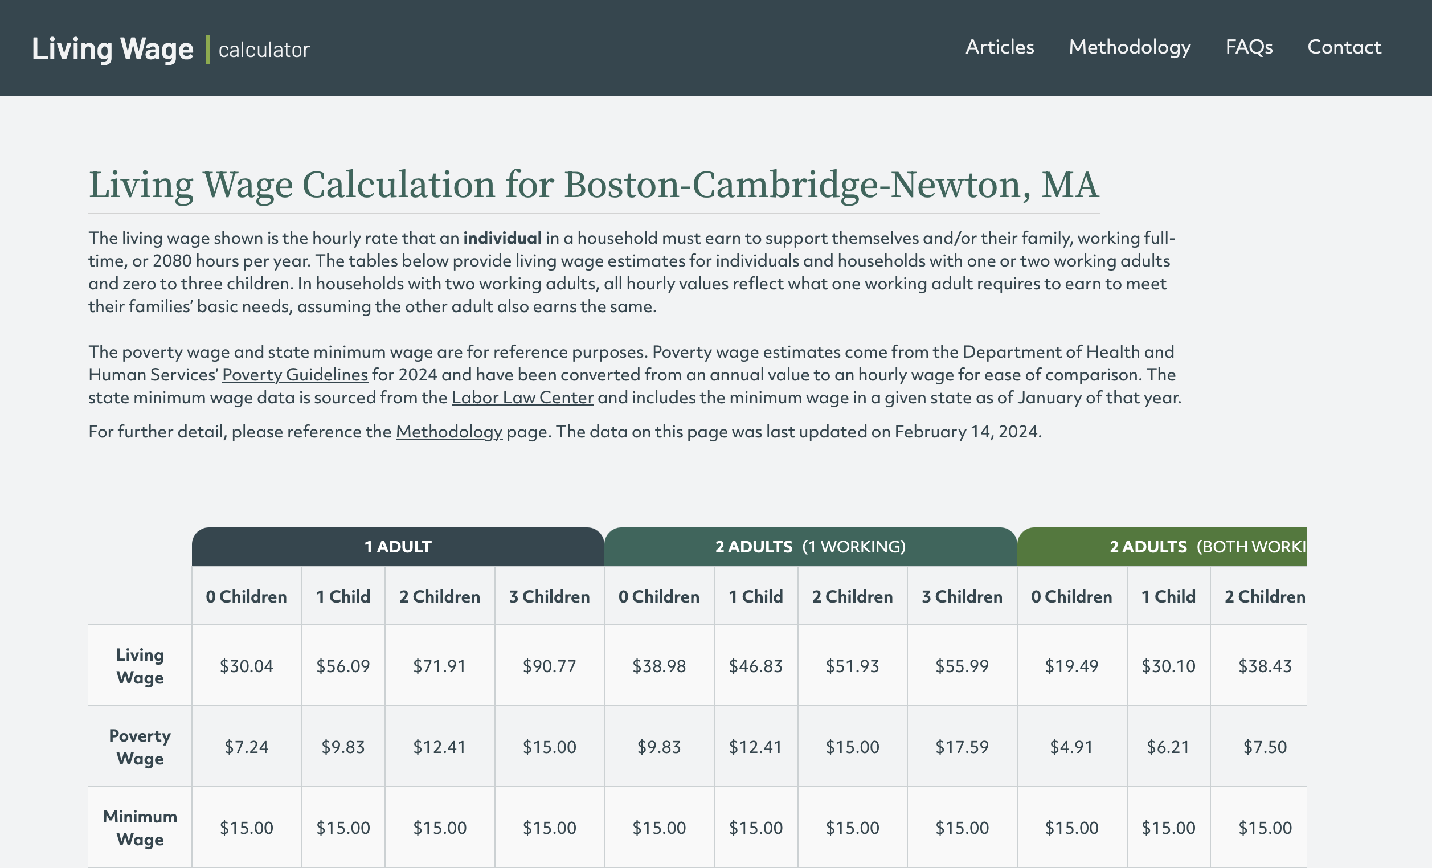
livingwage.mit.edu
$30.04/hr * 2080 hr = $62,483 living wage for the year
Notes:
Living wages have shot up in the US lately due to housing prices and other inflation; often grad stipends haven’t kept pace.

Slide 8
Healthcare
Medical
Vision
Dental
Notes:
In the US, healthcare is usually separated into medical, vision, and dental. Your program will likely only include Medical, but it may be possible to add on vision and dental. By default, it will only cover the student, but you can often pay to add a married spouse or dependents (typically children)

Slide 9
Healthcare
Many stressors in grad school
(Typically) new location and people
Grade stress (though classes become less important as one advances)
Qualifying exam
Research failure
Peer review rejection
Low stipends
Studies show depression is common in PhD students
How does mental health care work for grad students?
Mental
Notes:
In the US, healthcare is usually separated into medical, vision, and dental. Your program will likely only include Medical, but it may be possible to add on vision and dental. By default, it will only cover the student, but you can often pay to add a married spouse or dependents (typically children)

Slide 10
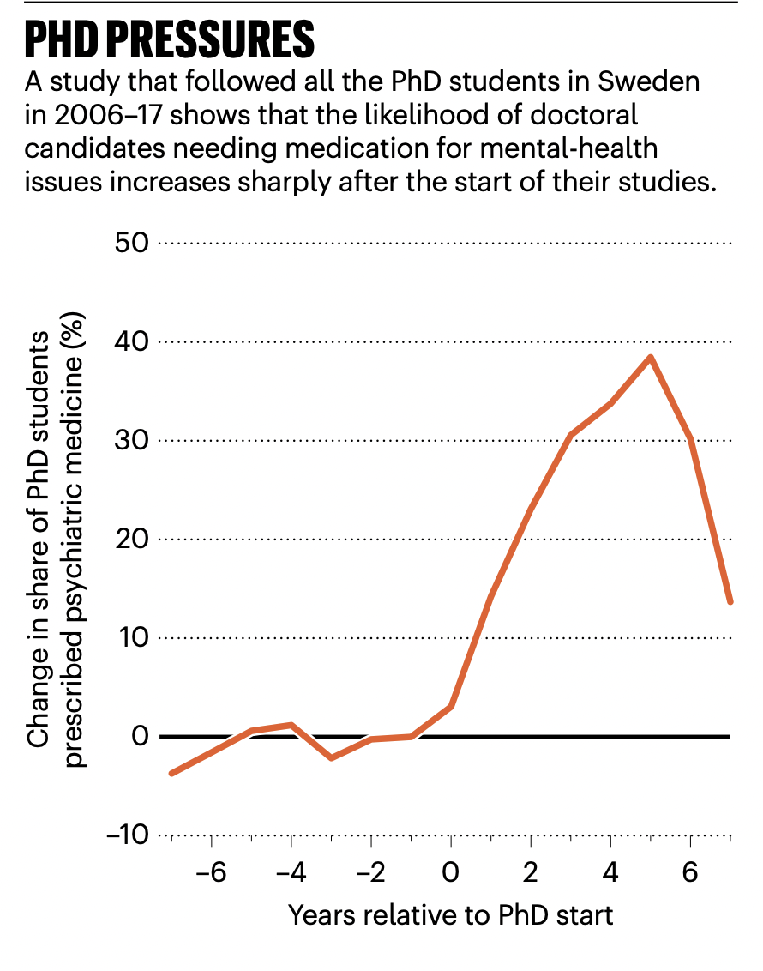
Mental health
Depression in US: 8.3%
Depression in UC Berkeley STEM grad students: 42-48%
Schwaller, 2024, describing Bergvall et al. 2024
Notes:
Note this doesn’t mean do not go to grad school if you face mental health challenges; it does mean that everyone going to grad school should consider potential issues and know how to get help for them and others

Slide 11
Mentorship
“Who was your advisor?” not “Where did you go to school?” Someone who will guide your career for 2-6+ years
Their personality, advising style, resources, and lab culture, will be very important
Identify potential advisor(s) first, then look at the department, school, and location
Photo of UN-NYG mentoring, IAEA Imagebank

Slide 12
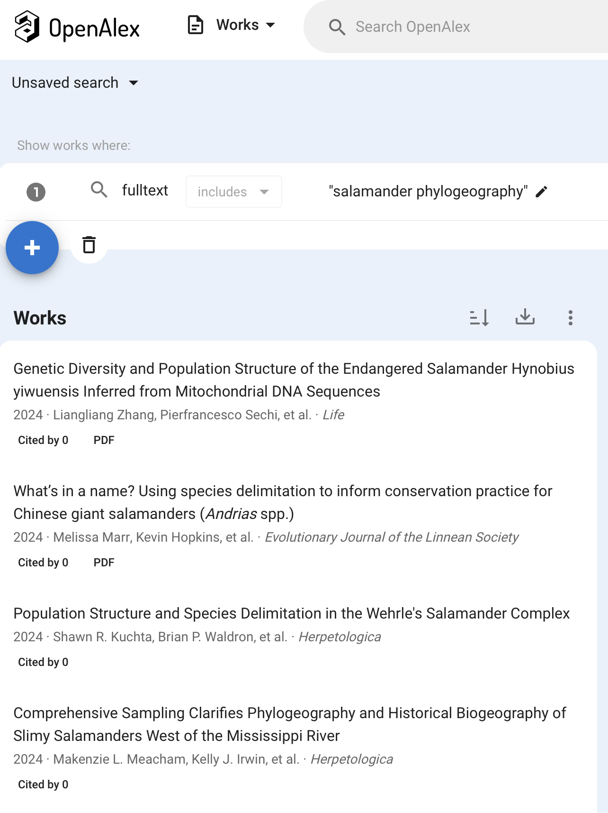
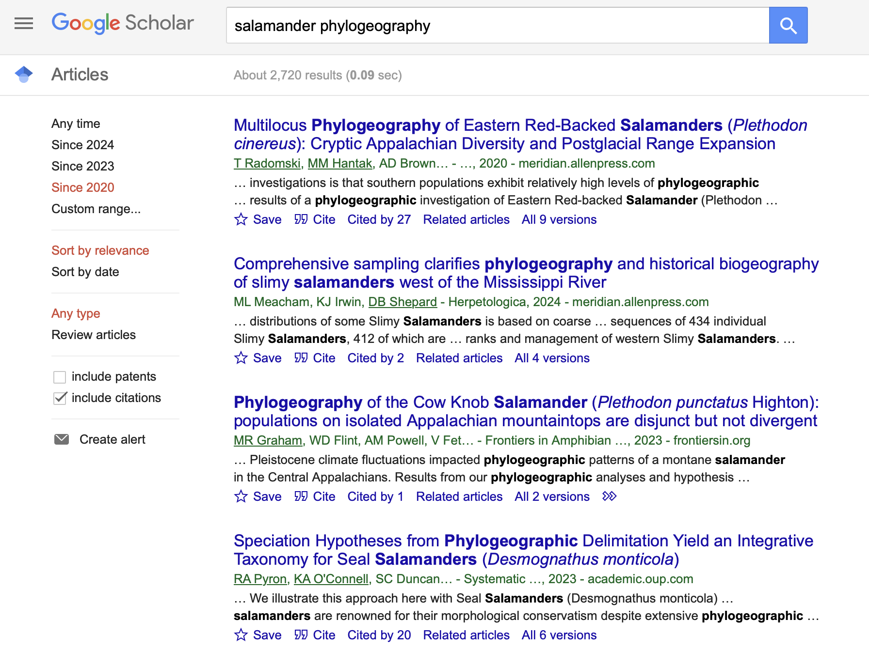
Notes:
Can look at all articles in your area of interest. See which ones look interesting, look at the authors involved (especially first and last authors)

Slide 13
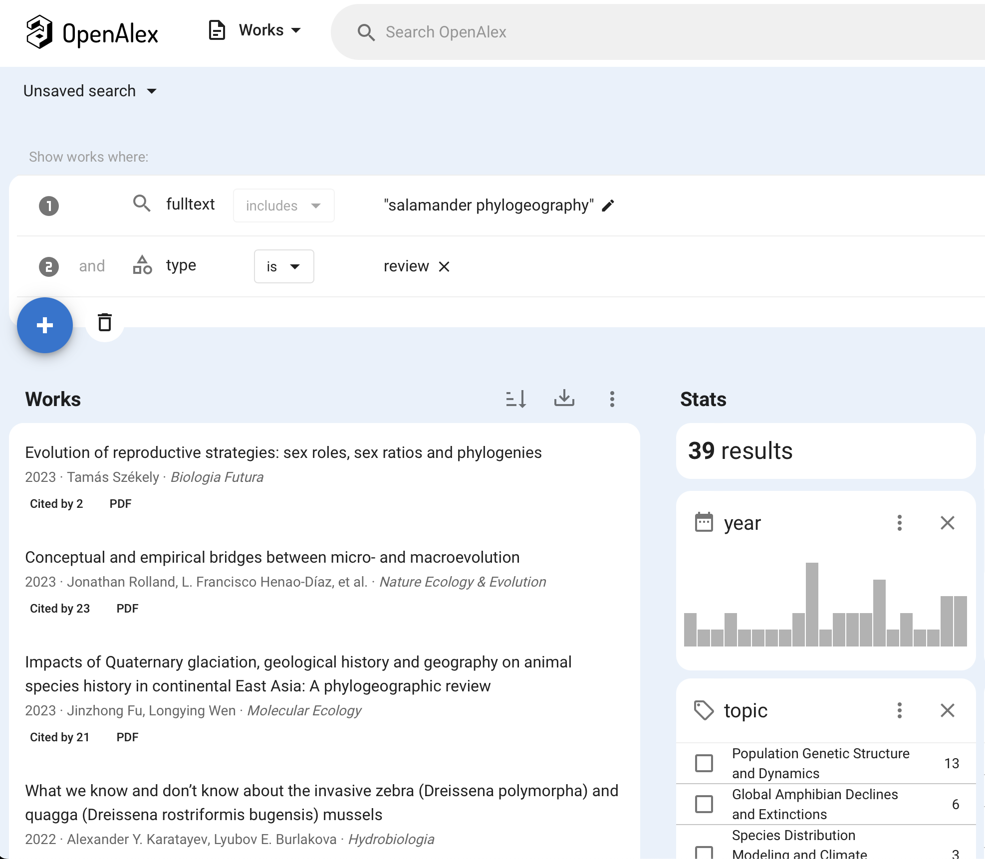
Notes:
Can also filter for just review articles. Good way to get overview of field, maybe see what work is cited within.

Slide 14
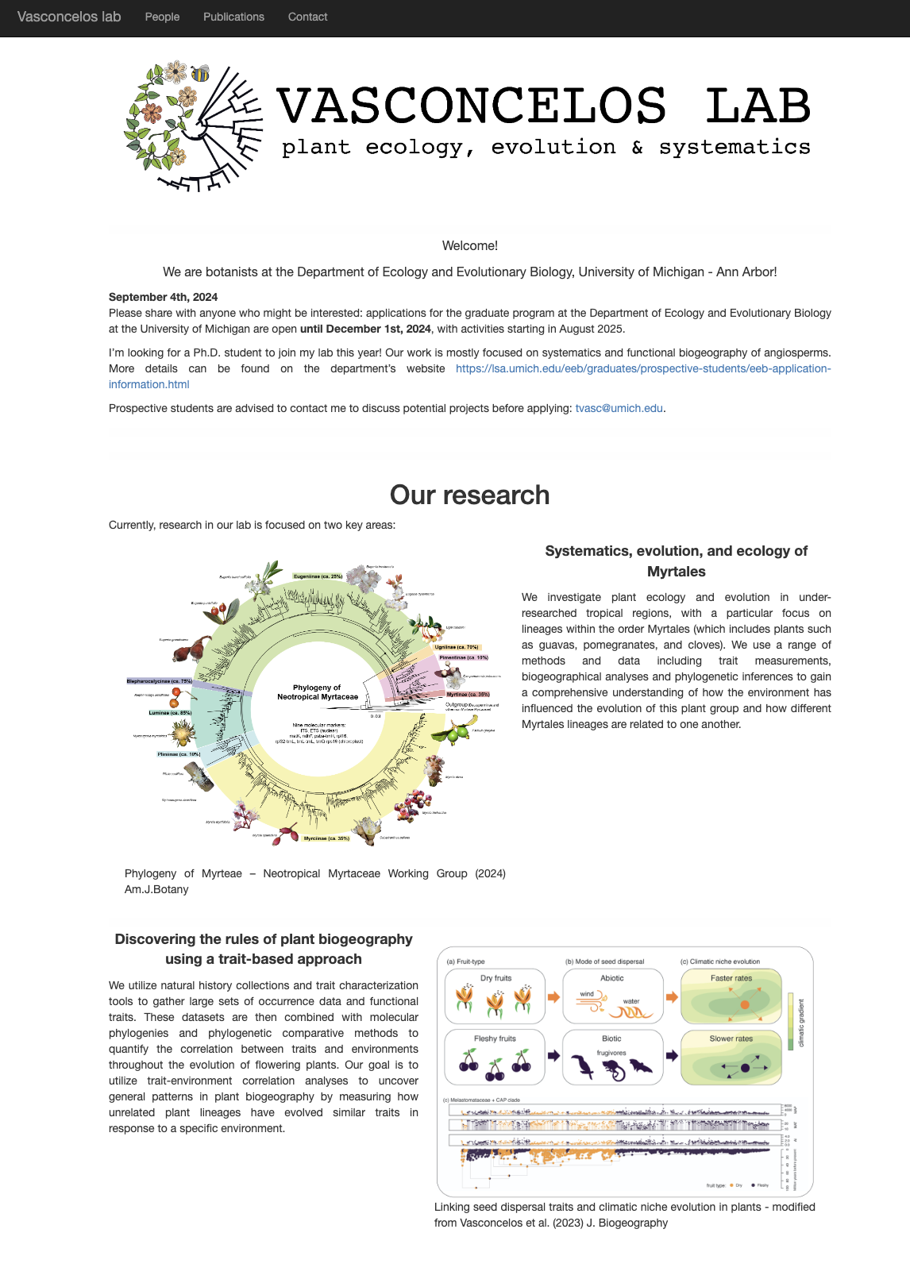
Used with permission

Slide 15
She wants students {
Used with permission

Slide 16
Info on who is in the lab
She wants students {
Used with permission

Slide 17
Recent publications: research active, see current directions
Info on who is in the lab
She wants students {
Used with permission

Slide 18
Recent publications: research active, see current directions
Info on who is in the lab
She wants students {
Used with permission

Slide 19
When evaluating advisor
Read their most cited and most recent papers
Get a sense of their priorities (website, social media, recorded talks)
Look at current and past students (Internet Archive’s Wayback Machine to look at “lab people” in earlier years; reach out to them)
Talk to current trusted people about the advisor
Check https://academic-sexual-misconduct-database.org/ (also good to see how the institution in general handles harassment)
What is their career stage? Are they on the tenure-track? Are they fairly new (less experience, perhaps more individual attention), near retirement, planning to move?
What do they expect of students? What can students expect of them?

Slide 20
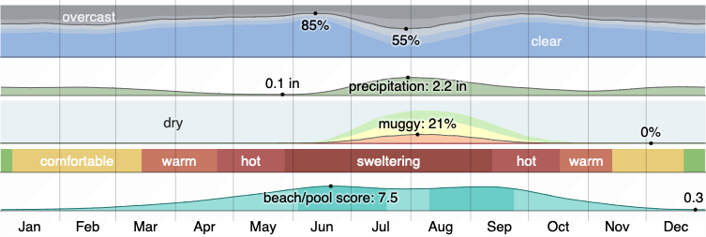
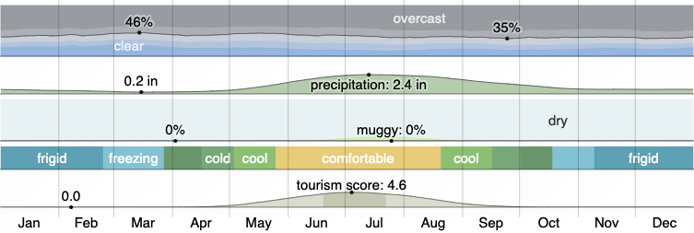
Location
Tucson, Arizona
Fairbanks, Alaska
Weather info ©WeatherSpark.com

Slide 21
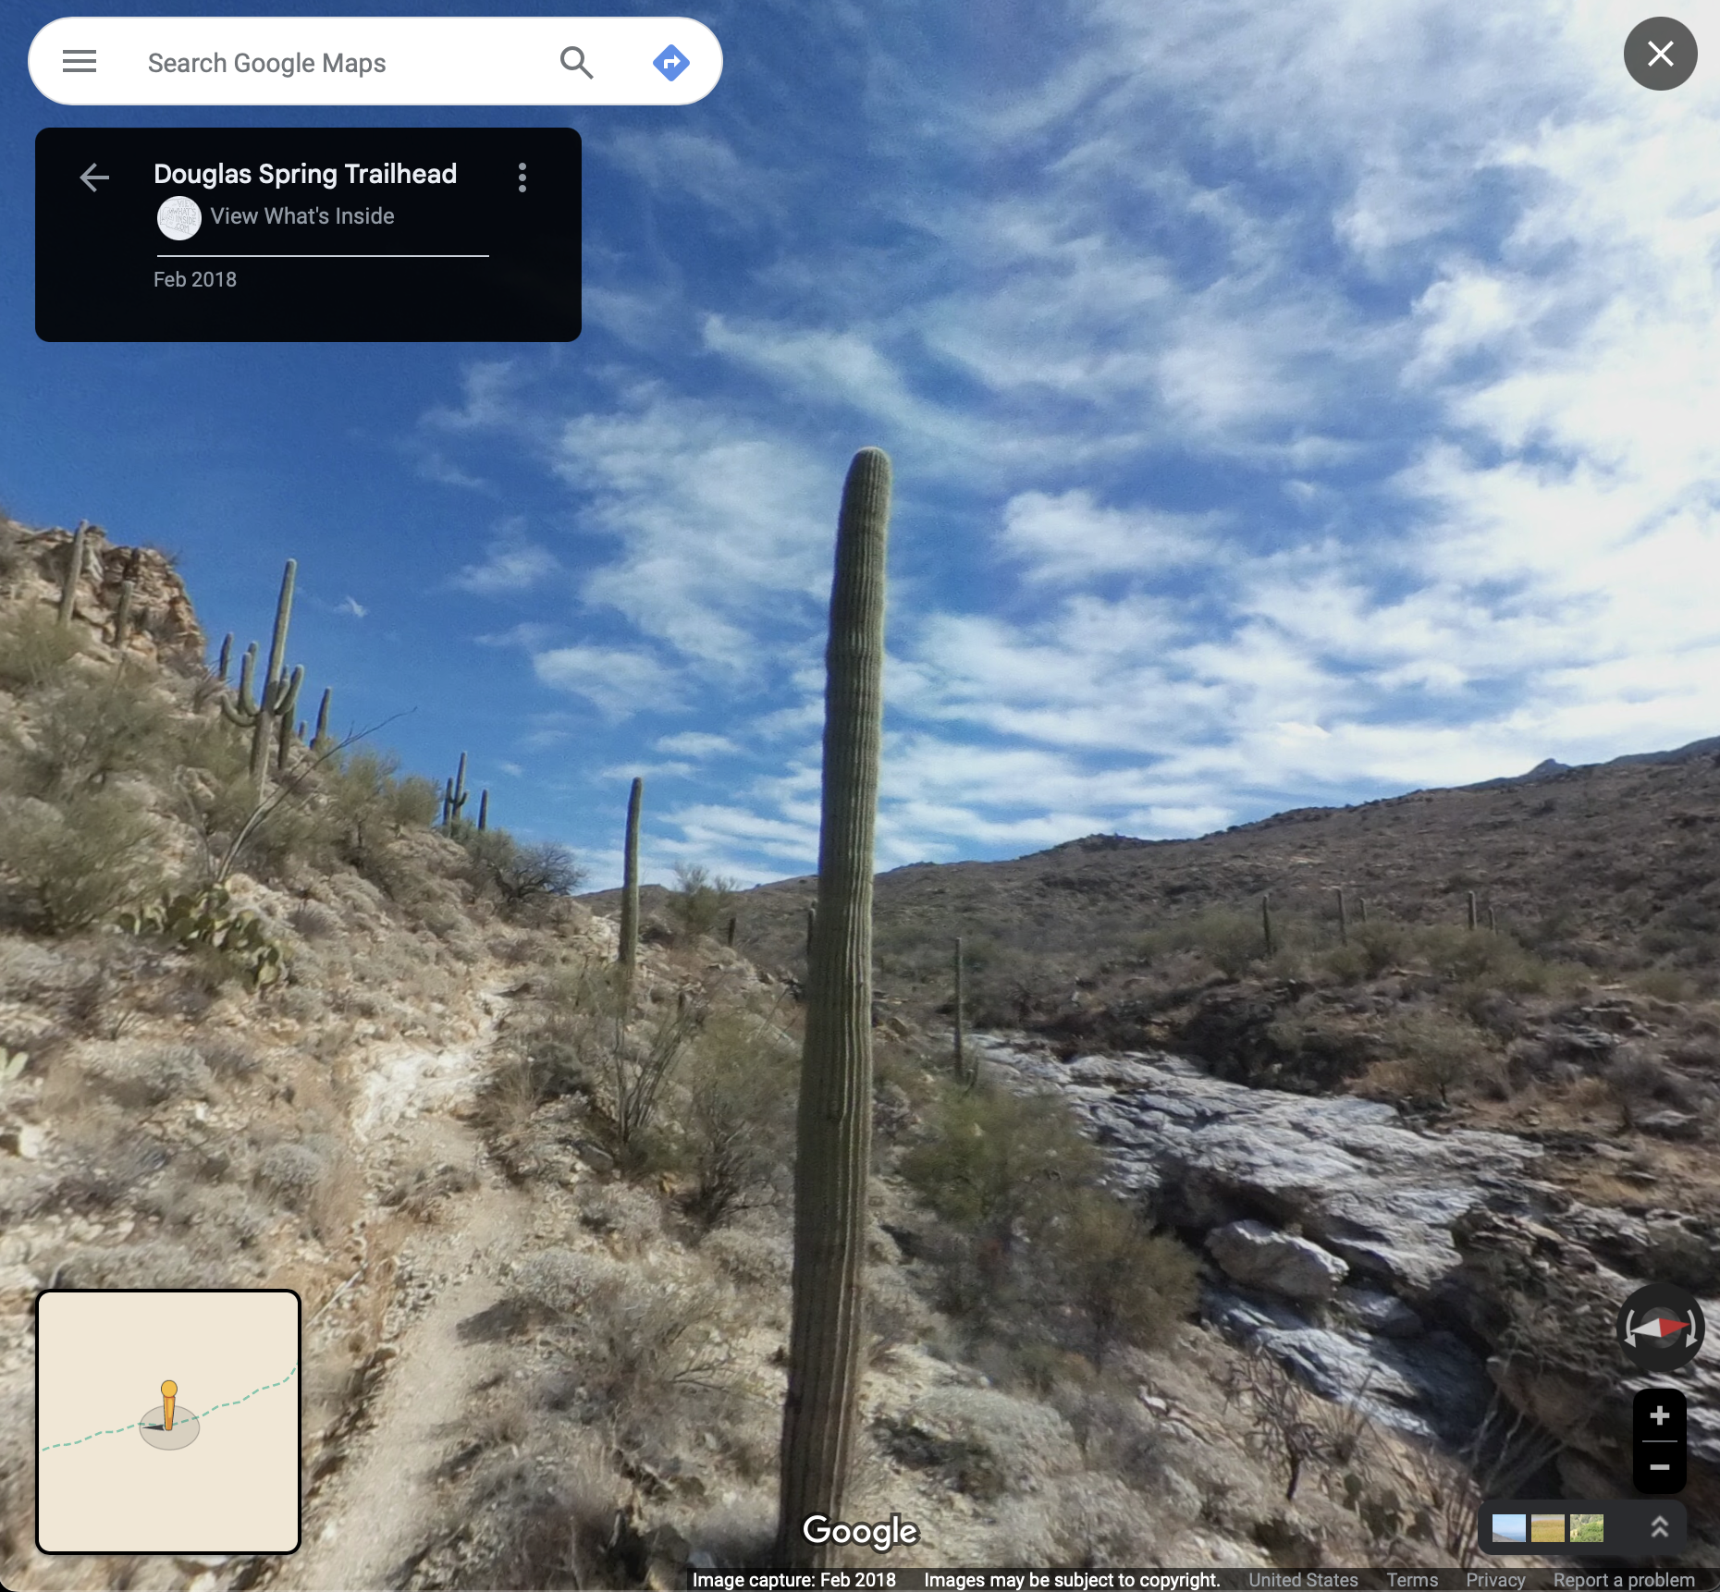
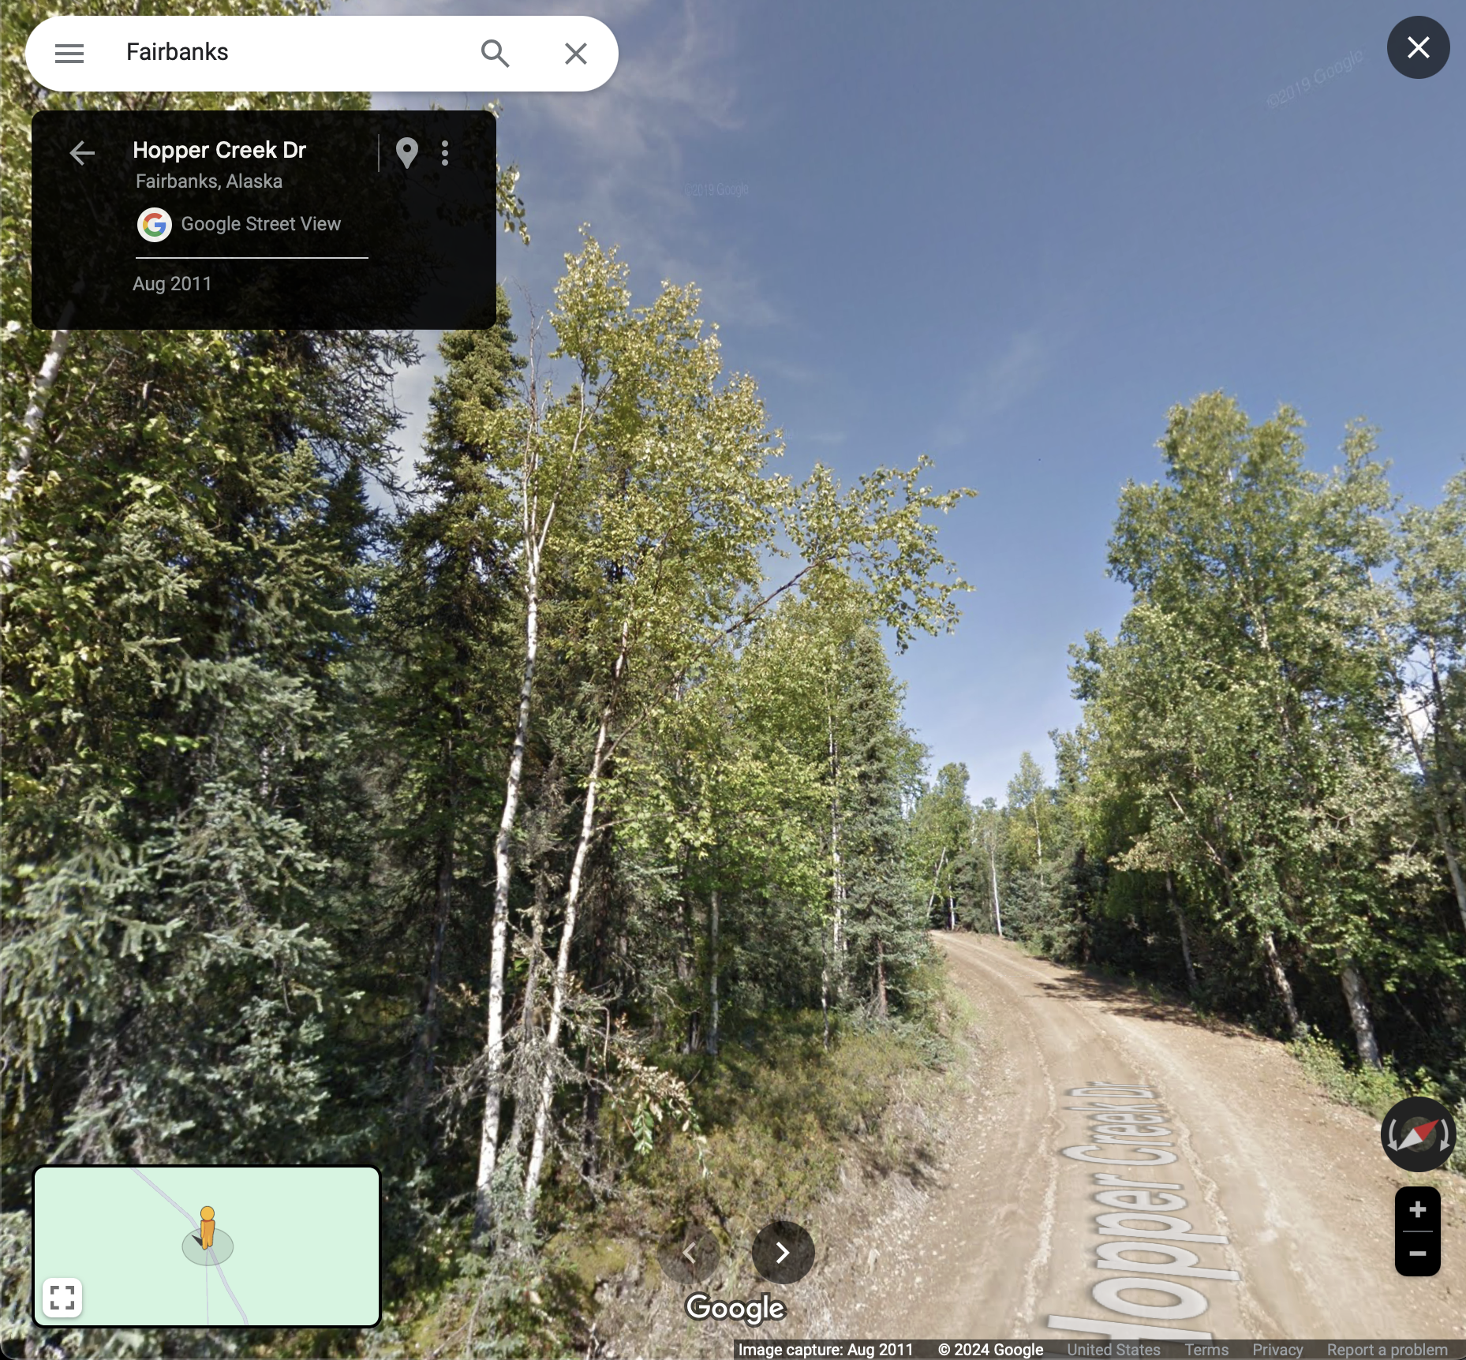
Tucson, Arizona
Fairbanks, Alaska

Slide 22
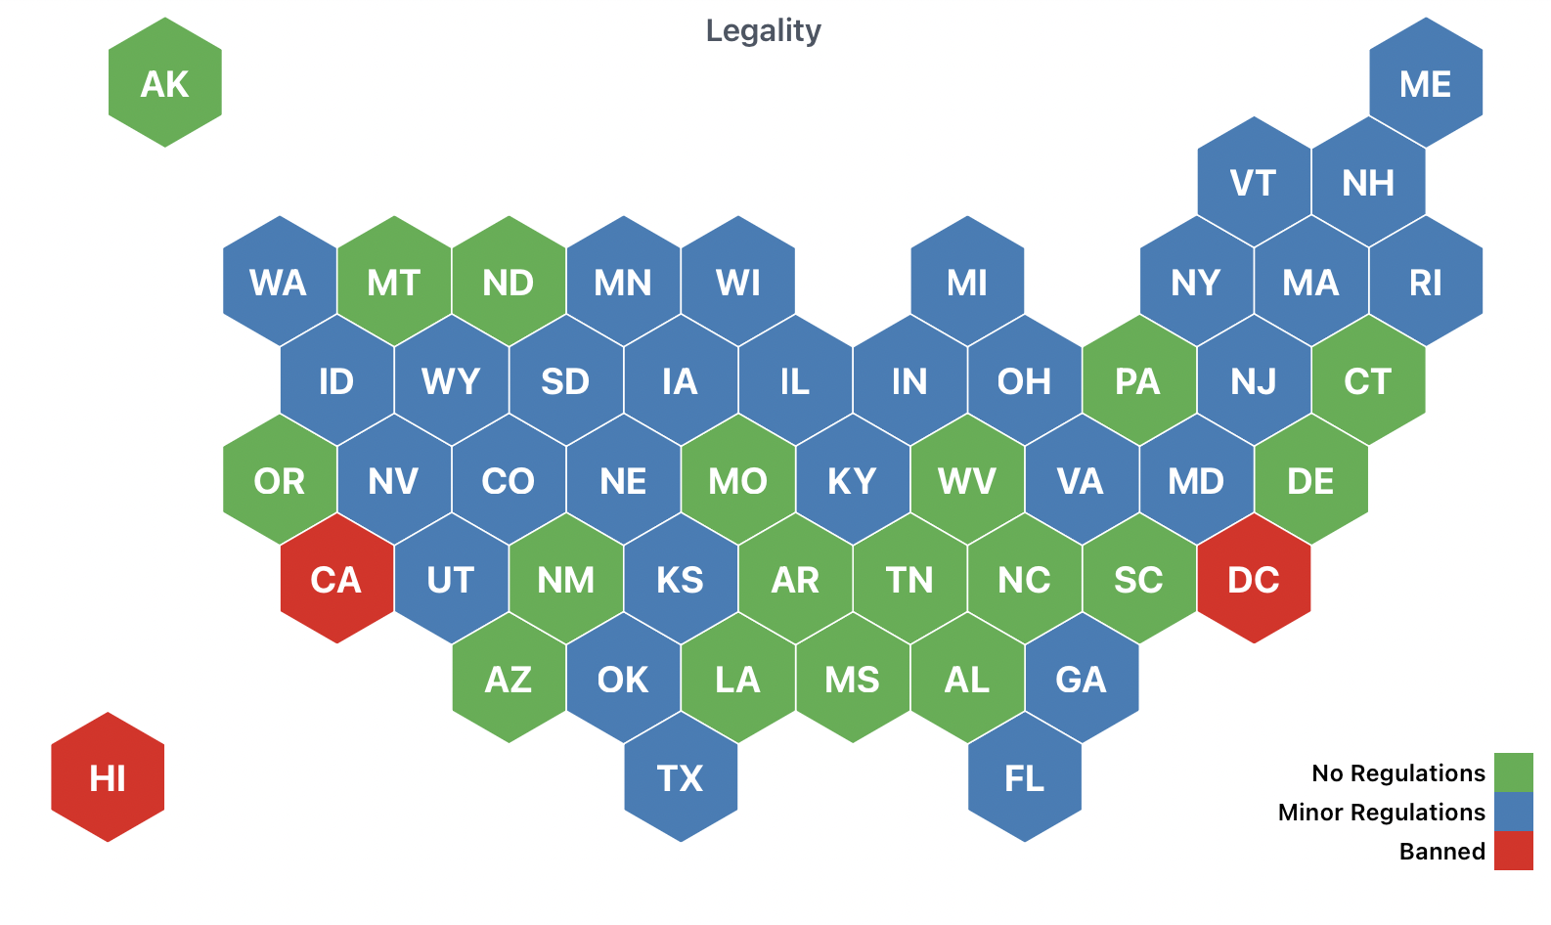
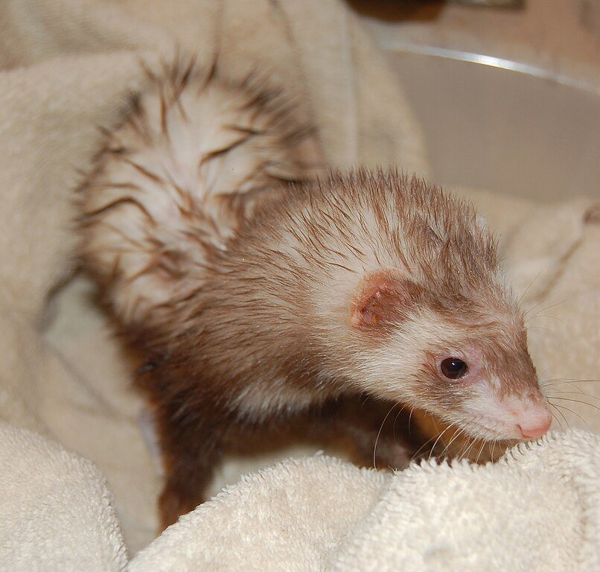
Notes:
An important thing about US is nesting of policies and laws: national, state, county, city, institution

Slide 23
US law
No regulation on keeping ferrets
State law
NY: Legal CA: Illegal
City / County law
Albany: Legal New York City: Illegal
College policy
Pets allowed on campus?

Slide 24
Gun policy: carry permits, types available, allowed use
Drug policy: legality of marijuana, severity of punishments for others (though note superseding federal regulations)
Abortion access
Gender-affirming care access
Rights / limits on protests
Handling of controversial topics
Whether diversity, equity, and inclusion programs are permitted
Frequency of racism, sexism, ableism, homophobia, and similar
Cost of housing
Some of the major axes of variation across regions or institutions
New axes can appear, and old ones go away, due to changes in law, news reports, and more
Notes:
We are not arguing you should care about all, or any, of these, or that there aren’t other axes that matter more to you. Nor are we saying which way you should choose: you might want to be in a place with access to certain kinds of health care, or you might want to be in a place that restricts them, or you might not care.

Slide 25
How long does it take students in this program to graduate on average?
What percentage graduate?
What careers do students pursue: working at nonprofits, government agencies, business, K-12 teaching, research in academia, …?
What training and resources does this program offer for your intended career path?
What resources are there for being safe in the lab and field?
How do students fund their research?
How does student funding work (from school, from grants)?
What do current and past students think of the program?

Slide 26
August-November: Identify and reach out to potential advisors
If you reach out and they don’t reply, try again a month later
October: Apply to NSF Graduate Research Fellowship Program
A 2 page essay on research, 3 page essay on you, possibility of a 3 year fellowship
November-December: Apply to grad school!
Check for deadlines
There may be fees to apply; there may also be fee waivers
January-February: Visits?
Some places may invite you out to a visit weekend (and pay for it); others may invite you to visit but you pay. Visits help you evaluate them and vice versa.
January-April (and sometimes later): Offer, rejection, or waitlist
Offer letter should have details of support: funding, how many years guaranteed (does it depend on your advisor getting a grant?), conditions
April 15: Typical deadline for acceptance
https://cgsnet.org/resources/for-current-prospective-graduate-students/april-15-resolution : but do accept or reject offers as soon as you can – help your waitlisted peers!

Slide 27
Applications
Transcripts
Letters of recommendation
Research statement
Personal statement
Diversity statement (sometimes)

Slide 28
International students
Visa required (up to US whether to grant)
Potential limits on funding (no NSF GRFP, for example)
Limits on outside paid work
Potential tests for showing English proficiency
Strikes, arrests, etc. might have different effects

Slide 29
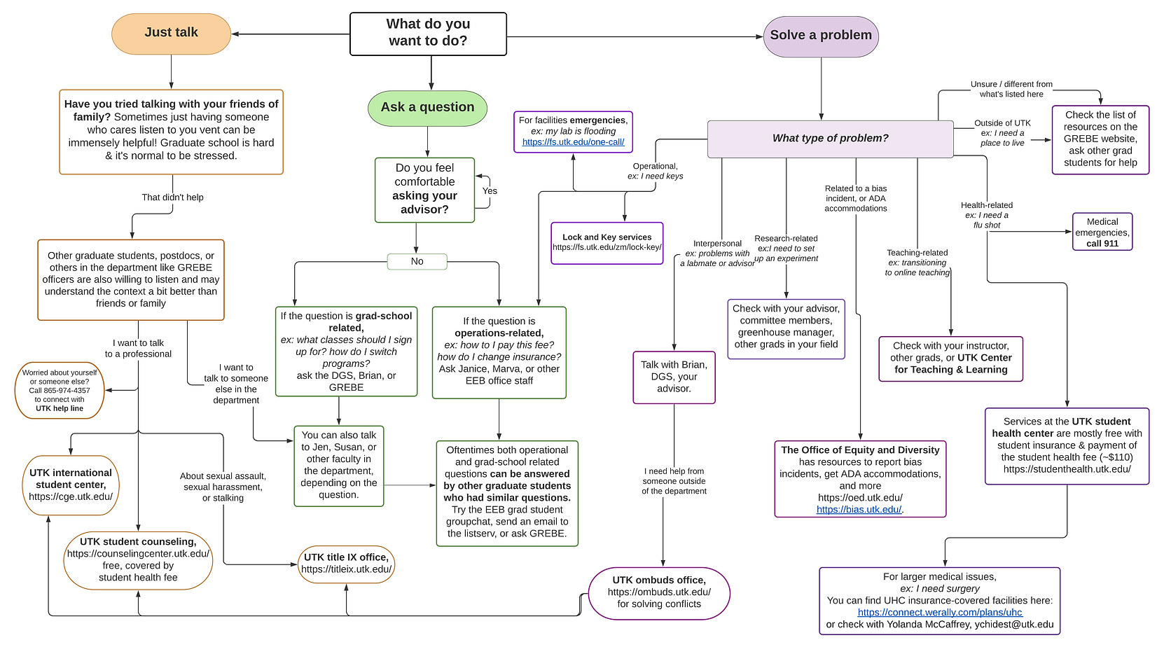
Consider power dynamics and getting help
UTK EEB Graduate student group, GREBE (diagram somewhat out of date)

Slide 30
Consider power dynamics and getting help
UTK EEB Graduate student group, GREBE (diagram somewhat out of date)

Slide 31
Consider power dynamics and getting help
UTK EEB Graduate student group, GREBE (diagram somewhat out of date)

Slide 32
Consider power dynamics and getting help
UTK EEB Graduate student group, GREBE (diagram somewhat out of date)

Slide 33
Consider power dynamics and getting help
UTK EEB Graduate student group, GREBE (diagram somewhat out of date)

Slide 34
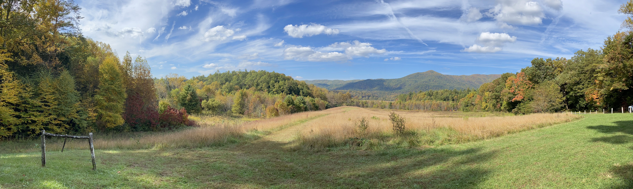
Discussion and Questions
ApplyingToEEB.info

